Slide 1
Resistance is Futile. . .
Tom Bigelow
New York Mycological Society
tom_bigelow@hotmail.com
the allure of Corticioid Fungi

Slide 2
What are corticioid fungi?
Fruiting bodies often resupinate, growing on wood, woody debris, bark, leaf litter, etc.
No taxonomic status, encompasses many genera in different orders and families
An artificial assemblage for the sake of convenience
Notes:
Corticioid = “Bark-like”
Broad definition, based on James Ginns conception of the group as presented in “Lingnicolous Corticioid Fungi of NA”
Defined by:
Habitat: on wood, bark, litter
2) Morphology: resupinate, effused-reflexed (with some other forms), having a smooth to spiny to merulioid, (etc.) hymenium
A heterogeneous (i.e., DIVERSE) assemblage; taxonomy is dynamic and unsettled
Burt and Coker treated the group in the in the FAMILY Thelephoraceae
More recently, they were grouped in the Aphyllophorales a now obsolete ORDER that encompassed fungi without gills or pores: crusts, stereoid fungi, cyphelloid fungi, hydnaceous fungi (volume 2 of Fungi of Switzerland)

Slide 3
What are they doing?
Most are saprobes
Some are pathogens, e.g., Chondrostereum
Some are parasites, e.g., Athelia, Exobasidium, Marchandiobasidium, Tremella
Some are endophytes, e.g., Peniophora, Phanerochaete
Most are white rotters – some brown-rotters are Leucogyrophana, Plicatura, Serpula
Some are mycorrhizal, e.g., Byssocorticium, Piloderma, Thelephora, Tomentella, Tulasnella
Notes:
Biotrophic parasites: form a relationship w/ living tissue rather than kill the host
Endophyte: a fungus that lives inside a plant
White rot consume lignin
Brown rot consume cellulose

Slide 4
When and where can they be found?
They can be found year-round
They occur on a wide range of substrates
They can be host-specific or generalists
Many are found growing under logs
Different species inhabit wood at different stages of decay
Notes:
COLD WEATHER vs WARM WEATHER SPECIES
SUBSTRATES:
Bark, living wood; dead wood attached (Aeurodiscus amorphous); dead wood on the ground; underside of logs;
Some are found in leaf litter or needle duff (Piloderma); leaves; Marchandiomyces species are parasitic on foliose lichen; species of Tomentella may fruit opportunistically on rocks
Some are host-specific, some are generalists, and occur on hardwood and conifer
UNDER LOGS:
Crust fungi fruiting on the underside of logs are insulated from cold (esp. if there’s snow on the ground)
Underside of logs can also help protect fungus from drought
LOG ROLLING: Use care during when collecting so as to minimize disturbance of the collection site. Many species grow under wood; overturning logs can have negative consequences for fungi, insects, amphibians, reptiles, seedlings, etc. Returning logs and large branches to their original position will help to lessen the disturbance . . .
SUCCSESSION:
Diseased wood vs healthy wood; environmental factors (sunlight, lack of moisture, too much moisture, etc.)

Slide 5
Why bother with corticiod fungi?
By ignoring them, we’re not getting the full picture of agaricomycete diversity
They play a crucial role in the environment
They are poorly known in North America
They are overlooked by amateur mushroom clubs; are underrepresented in regional and national mushroom forays; are omitted from field guides
Notes:
Not necessarily uncommon or hard to find – they are overlooked
Important role as decomposers; or mycorrhizal partners
important food source for insects and other denizens of the undersides of logs
They are incredibly diverse: Ginns (1995) treats 1,163 species distributed among 21 orders and 54 families – numbers have only increased in the intervening 25 years
Last comprehensive treatment of NA species was published over 90 years ago (Burt, Thelephoraceae of North America), published between 1914-1926; and they are absent or at best, woefully under represented in field guides
NEFM Foray in 1999, of 307 taxa collected, 4 were corticioid (and that must have been a dry year); at NEMF last year, of 563 taxa collected, 19 were corticioid species
Hard to track down the widely scattered literature – most of which is European
They are abundant and easy to collect, even when other mushrooms are scarce (winter, dry weather, etc).
Their macromorphology may be simplified, but their microstructures are extremely diverse. Tom Volk has pointed out that in many respects corticioid fungi are easier to work with than many polypores, as they generally have more micro features
They are said to lack “Charisma” – if you are of this opinion, I hope that seeing some of these often stunning fungi will dissuade you of it

Slide 6
What I’d like to leave you with. . .
Ability to recognize common genera and species
Awareness of diagnostic features (macro & micro) which need to be evaluated
Knowledge of where to find the literature (monographs, keys, descriptions, illustrations, etc.)
Knowledge of how to proceed when faced with an unknown crust fungus
Notes:
Many of the fungi you’ll see in this presentation can be identified w/o a microscope
See biblio hand out; much of the literature is available online…

Slide 7
What to do when confronted with an unknown corticioid fungus?
Note substrate, growth habit, gross morphology; take pictures, make drawings
Under the microscope, look for septa and clamps in hyphae; note if hyphal walls are thick or thin; look for clamps at the base of basidia
Check number of sterigma on the basidia (usually 4, can be 2 to 8)
Measure spores; note spore shape and ornamentation (may require Melzer’s Reagent)
Note sterile organs, e.g., cystidia, hyphidia, etc.
Make a second preparation with Melzer’s Reagent to check for amyloid or dextrinoid reactions
Take pictures, make drawings of micro features
Notes:
Take notes and document
Micrscope

Slide 8
What to do when confronted with an unknown corticioid fungus?
After you’ve gathered your data, try running through a key
Share your data online (mushroomobserver, inaturalist, the “Crust and Polypores” facebook group)
Preserve your collections
If your club is participating the NAMP, voucher and sequence your collections!
Notes:
Keys, e.g., Corticiaceae on Northern Europe, Vol. 1; Corticiaceae s.l.; Julich & Stalpers; etc.
Compare different keys to see how they're constructed
You may not get to species, but your chances of keying something out to genus are pretty good...
If you hit a wall, try a different key; if you hit a wall again, post your notes, pictures, and data online, eg., on mushroomobserver or inaturalist... - Crust Fungi and Polypores fb page and see what Annarosa Bernicchia, Django Grootmeyers, Bjorn Wergen have to say;
Document, Voucher, Sequence collections!!

Slide 9
Fruit Body Types: Resupinate
z
Corticium
Myxarium
Peniophora
Phlebia
Terrana
Vararia
Xenasmatella
Notes:
This and following illustrations are from “Corticiaceae of Northern Europe”, Vol. 1
Flat on the substrate with the hymenium on the outer side
Resupinate fbs can have numerous hymenium types, from smooth, to spiny, to tuberculate, to merulioid….
resupinate fbs will be adhered to the substrate, sometimes easily removable, sometimes strictly adhered

Slide 10
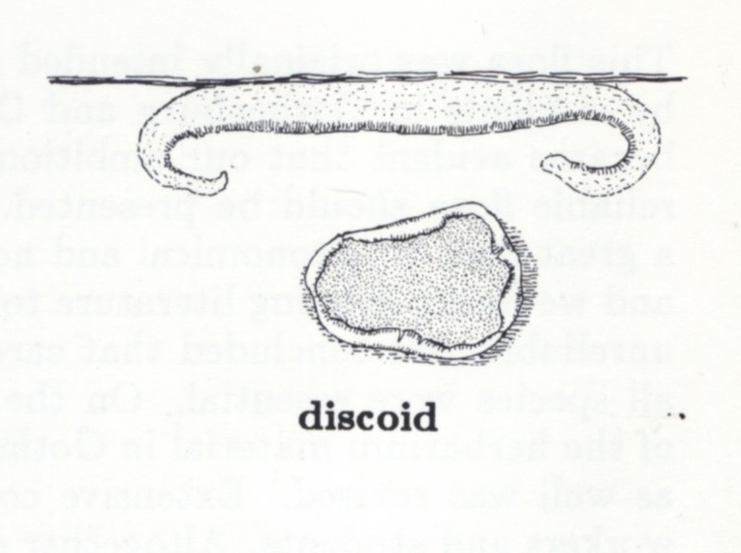
Fruit Body Types: Discoid
z
Aleurodiscus
Licrostroma
Notes:
Can sometimes look suspiciously like discomycetes
Licrostroma uses "splash cups" as a means to disperse asexual spores ...

Slide 11
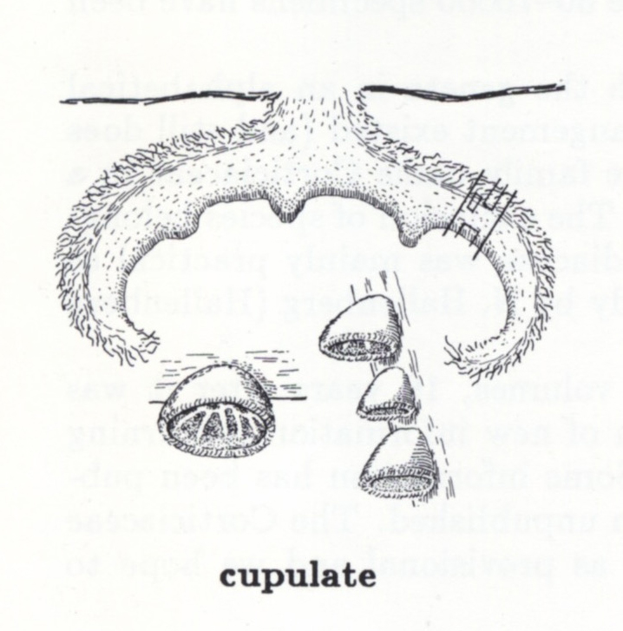
Fruit Body Type: Cupulate (Cyphelloid)
z
Flagelloscypha
Henningsomyces
Maireina
Merismodes
Resupinatus
Notes:
Some species of Aleurodiscus are cupulate as well…

Slide 12
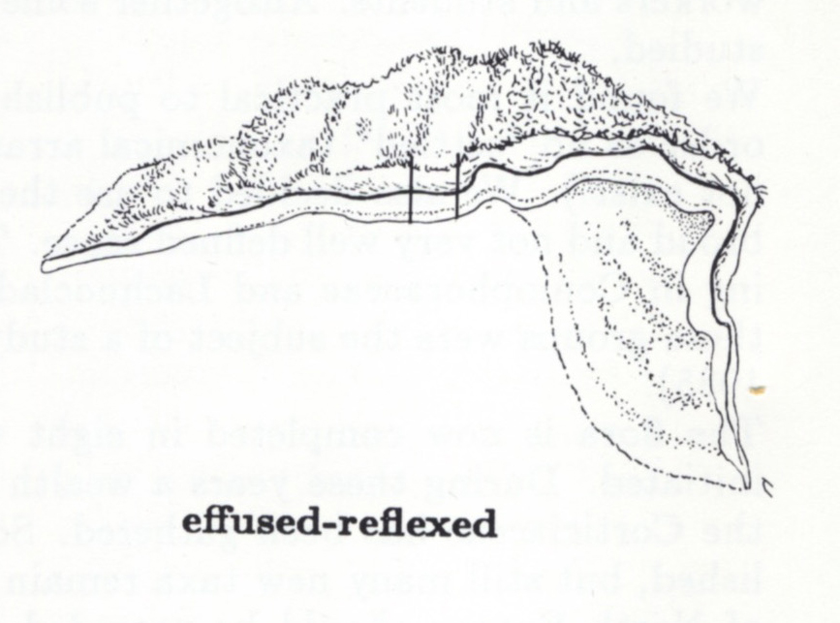
Fruit Body Types: Effused-Reflexed (Stereoid)
z
Chondrostereum
Cystostereum
Punctularia
Stereum
Xylobolus
Notes:
fruit bodies are stretched out over the substrate, but turned up at the edge to make a pileus
Stereum, etc

Slide 13
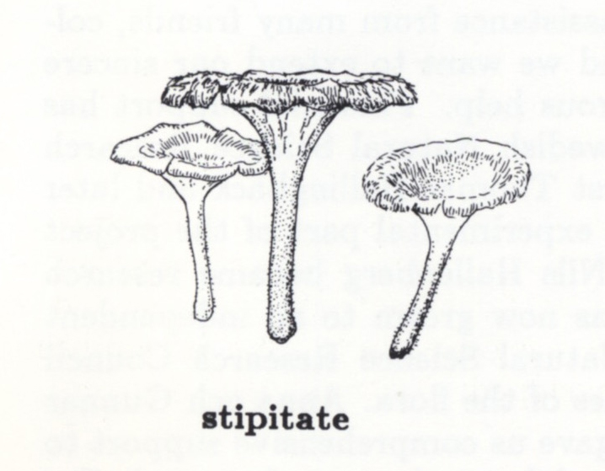
Fruit Body Types: Stipitate
z
Cotylidia
Guepiniopsis
Podoscypha
Thelephora

Slide 14
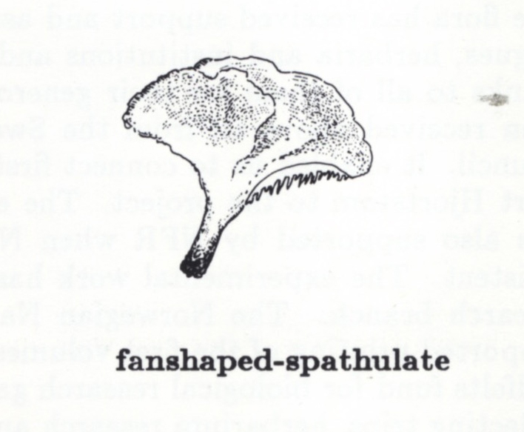
Fruit Body Type: Spathulate/Flabellate
z
Stereopsis
Dacryopinax
Thelephora
Notes:
Spoon or spatula shaped
some jelly fungi

Slide 15
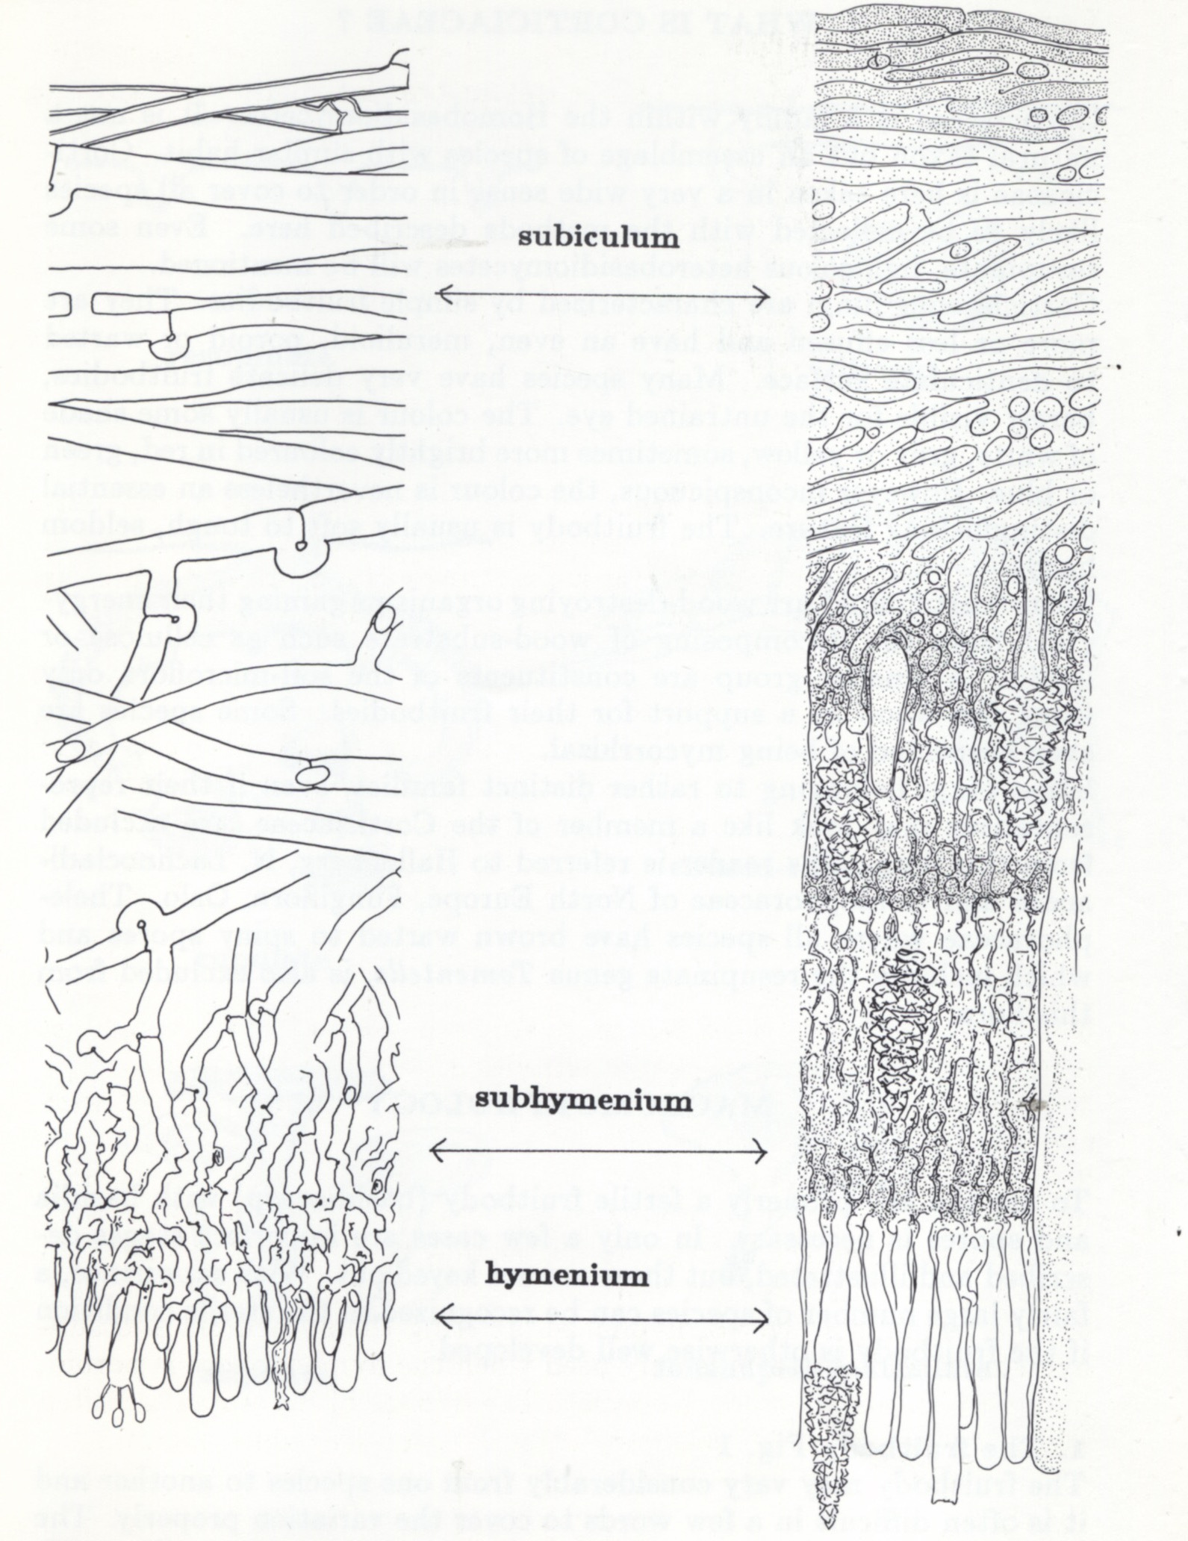
Construction of Corticioid Fruit Bodies
z
Subicular hyphae
Subhymenium
Hymenium
Notes:
generally applies to all fb types
Subiculum: generative hyphae (monomitic); generative + vegetative hyphae (dimitic); hyphae with or without septa & clamp connections. Most corticioid fungi are monomitic
Subhymenium: cystidia, hyphidia, septa, clamp connections
Hymenium (fertile surface): Basidia, cystidia

Slide 16
Resupinate Fruit Bodies
Flat on the substrate with the hymenium on the outer side
Hymenium can be spiny (toothed), warted, reticulate, merulioid, smooth, etc.
Consistency can be leathery, cottony, waxy, granular, mealy, rubbery, gelatinous, etc.
They can be firmly or loosely attached to the substrate

Slide 17
Corticium roseum
Notes:
ORDER: Corticales
FAMILY: Corticiaceae
Very common – on a wide variety of hardwood limbs, bark, wood, branches, logs on the ground, fall/winter

Slide 18
Corticium roseum a. Section through fruit body b. Hypha c. Spores d. Dendrohyphidia e. Basidia f. Probasidial bladder
Notes:
x-section showing subiculum, subhymenium, hymenium
Monomitic - generative hyphae only
Dendrohyphidia: irregularly strongly branched hyphidia;
Hyphidium is a slightly, or strongly, modified terminal hypha in the hymenium

Slide 19
Dendrothele nivosa
Notes:
ORDER: Corticales
FAMILY: Corticiaceae
A mild parasite on bark of eastern red cedar. Tree can be identified by the fungus!
Resistant to drought & high temps
Other common species of Dendrothele require microscopy and can be found on oak, maple, etc. (Dendrothele acerina, Dendrothele alliacea, etc.).
All species are harmless, consuming dead tissue….

Slide 20
Peniophora albobadia (Giraffe Spots)
Notes:
ORDER: Russulales
FAMILY: Peniophoraceae
Does not require microscopy.
the most common fall/winter species of Peniophora in the NYC area - grows on sticks on the ground, wooden tools, wooden bbq equipment, etc.
I often see if growing on the same piece of wood as Peniophora incarnata, another common cold weather species, fall/winter/spring; P. aurantiaca is somewhat similar, but occurs on alder
sometimes see it growing on the same stick together with Peniophora albobadia (on Sunday, NYMS found a stick with P. albobadia, P. cinerea, P. incarnata)
It’s common name was bestowed by NYMS member Vicky Tartter a couple of years ago and is now in common usage, e.g., on iNaturalist

Slide 21
Peniophora rufa
Notes:
ORDER: Russulales
FAMILY: Peniophoraceae
Does not require microscopy;
Occurs mostly on aspen.
unusual shape - Pulvinate (cushion-like) fbs; in dry weather, they shrink, and become pale and look like an nectria…

Slide 22
Phlebiopsis crassa
Notes:
ORDER: Polyporales
FAMILY: Phanerochaetaceae
Formerly in Porostereum and Phanerocheate.
common on a wide variety of fallen hardwood branches; late fall through winter
large encrusted cystidia.
Corticium roseocarneum, has a similar macro look, and is also found on dead hardwood branches - it has long, tubular (non-encrusted) cystidia

Slide 23
Rhizochaete radicata
Notes:
ORDER: Polyporales
FAMILY: Phanerochaetaceae
Three species R. americana, R. filamentosa, R. radicata were all once identified as Peniophora filamentosa.
R. filamentosa & R. radicata formerly in Phanerochete; (R. americana formerly Ceraceomyces americanus).
All three occur in the NE and all 3 are characterized by rhizomorphs, a purple/red staining reaction with KOH.
R. radicata is separated by having thick walled cystidia, generally over 50 microns, and slightly broader spores than R. filamentosa.
Very common early summer through fall on a wide variety of hardwood.
Fruit bodies of 3 species in the NE are easily separable from substrate, with loose, cottony, cob-webby margin, and cordons…

Slide 24
Rhizochaete radicata Rhizochaete filamentosa
a. Subicular hyphae
b. Basidiospores
c. Basidia
d. Cystidia
Notes:
TOP - R. radicata
BOTTOM - R. filamentosa
a. subicular hyphae simple septate, occasional clamps, encrusted;
b. spores short, cylindrical to ellipsoid (broader than spores of R. filamentosa);
d. thick-walled, encrusted cystidia (R. filamentosa’s are thin walled, generally shorter)

Slide 25
Terana caerulea (Cobalt Crust; Blue Velvet Crust)
Notes:
ORDER: Polyporales
FAMILY: Phanerochaetaceae
Formerly Pulcherricium ("most beautiful”) caeruleum (“blue”).
On fallen branches of hardwood trees (mostly oak).
No microscopy needed.
More commonly collected in the SE, Juniper & I found it in Great Swamp and the NYMS finds it in Cunningham Park, Queens, two years in a row in the same place, the same week (early November);
CVMS has found it a couple of times (NE Connecticut).

Slide 26
Xenasmatella vaga
Notes:
ORDER: Polyporales
FAMILY: Xenasmataceae
Very common, late spring through fall, all kinds of woods (deciduous and coniferous) - underside of logs
Composed of branched anastomosing hyphal threads (cordons), arranged in a fan-like manner
Delicate, easily detached from substrate
Varying in color, but always with shades of brown and yellows (esp. the sterile parts)
Margin fimbriate, usually paler
Cordons running through the fb, often extending beyond the margin
Doesn’t require microscopy – but Monomitic, (generative hyphae only) with clamps
Hyphae of cordons encrusted with rectangular crystals
Spores subglobose, strongly verruculose (having small, rounded warts), non-amyloid

Slide 27
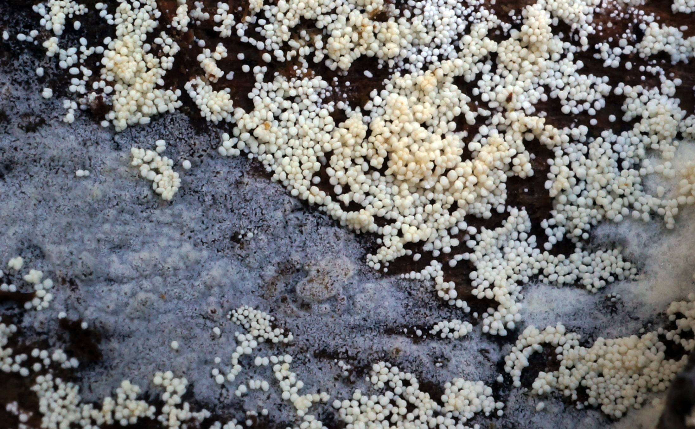
Bulbillomyces farinosus
Notes:
ORDER: Polyporales
FAMILY: Meruliaceae
if you've spent any time with Larry Millman, you know this fungus (found it with him 8 yrs ago in CP!)
This is the anamorphic state of Bulbilomyces farinosus (when fungi had separate names for anamorph and teleomorph, the anamorph – pictured here - was known as Aegerita candida)
Aggregation of tiny bulbils (bulb-like structures) balls (or bouys), very loosely attached to rotting wood near running water; they are dislodged by the water and are float off, carried away by the current;
the teleomorph, which can be found nearby (sometimes as a subiculum supporting the anamorph), is a pale gray, finely papillate crust

Slide 28
Hydnophlebia chrysorhiza (Spreading Yellow Tooth)
Notes:
ORDER: Polyporales
FAMILY: Meruliaceae
fka Phanerochaete chrysorhiza
growing over a Tomentella....

Slide 29
Radulodon copelandii (Asian Beauty)
Notes:
ORDER: Polyporales
FAMILY: Meruliaceae
The genus Radulomyces:
ORDER: Agaricales
FAMILY: Pterulaceae

Slide 30
Etheirodon fimbriatum
Notes:
ORDER: Polyporales
FAMILY: Steccherinaceae
Until recently in the genus Steccherinum – genus H.J. Banker published the name Etheirodon in 1902….
Odontoid spines (as opposed to the hydnoid spines of S. fimbriatum)
Pale violaceus, gray-reddish
Filamentous / rhizomorphic margin
Dimitic (generative & skeletal hyphae)
Occurs on a wide range of wood (mostly hardwood, but occasionally conifer)

Slide 31
Steccherinum ochraceum (Ochre Spreading Tooth)
Notes:
ORDER: Polyporales
FAMILY: Steccherinaceae
Sometimes effused-reflexed…

Slide 32
Tulasnella violea
Notes:
ORDER: Cantharellales
FAMILY: Tulasnellaceae
George Willard Martin included Tulasnella in the Tremellales in Revision of the North Central Tremellales (1952)
species of Tulasnella are mycorrhizal with orchids
Very common - winter

Slide 33
Discoid Fruit Bodies
Aleurodiscus
Licrostroma
Splash cups

Slide 34
Aleurodiscus amorphus (Orange Disco)
Notes:
ORDER: Russulales
FAMILY: Stereaceae
in 1801, Persoon named this fungus Peziza amorpha (didn’t use a microscope!)
genus characterized by large, ornamented spores, and acanthophyses (sometimes called paraphyses), and dendrohyphidia.
This species grows most commonly on dead, attached lower branches of fir and spruce – but J & I have also found it on spruce logs.
iNaturalist gives it the uninspired common name “orange disco”, which I think is rather misleading….
the other common species is Aleurodiscus oakesii, on hornbeam

Slide 35
Aleurodiscus amorphus
Cystidia
Paraphyses
Basidiospores
Notes:
A. Large cystidia, 110 – 160 microns;
B. acanthophyses = paraphyses with brush-like projections; up to 140 microns;
C. Spores subglobbose to broadly ellipsoid, 28 x 22 microns, densely covered with blunt spines

Slide 36
Licrostroma subgiganteum
Notes:
ORDER: Corticales
FAMILY: Corticiaceae
This is the asexual (anamorphic) fructification, with splash cups forming chlamydospores;
the splash cups always facing up
NEXT SLIDE…

Slide 37
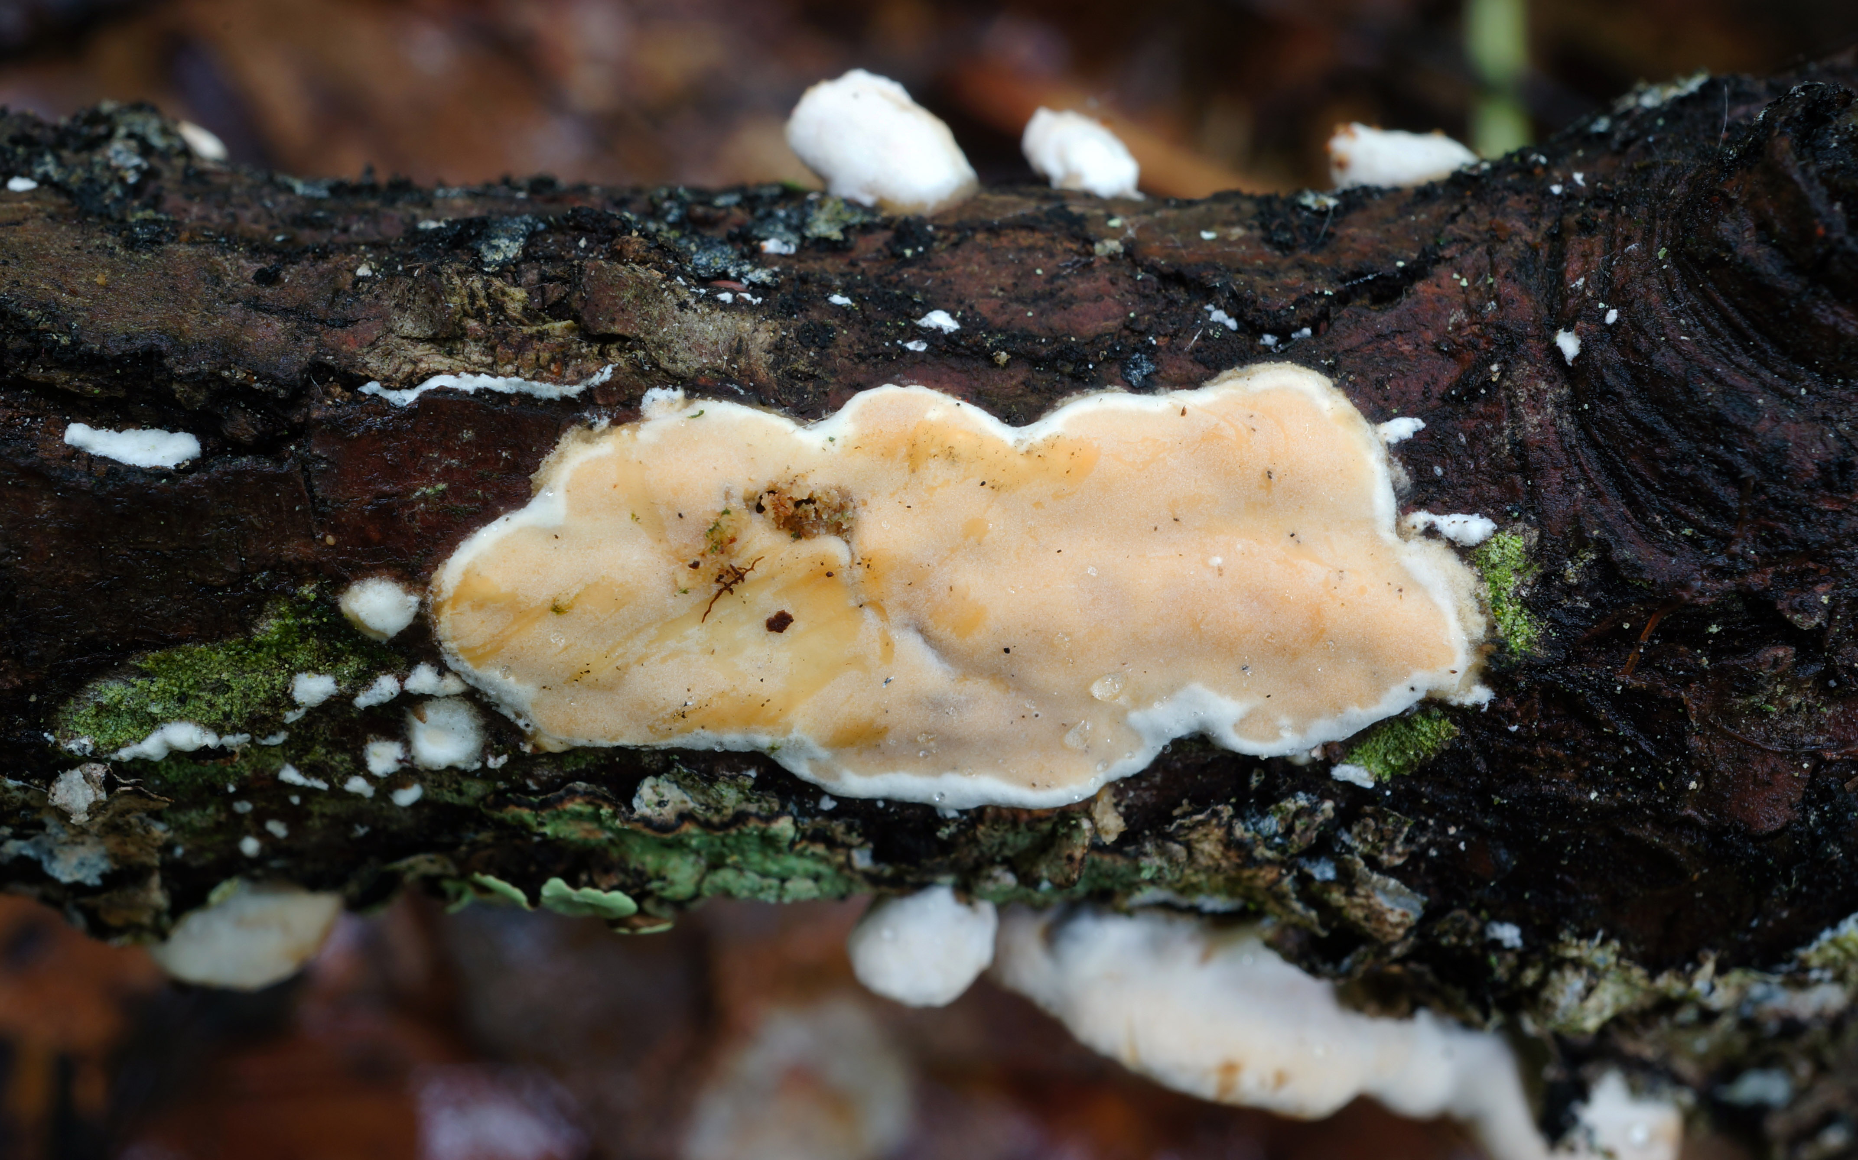
Licrostroma subgiganteum
Notes:
the teleomorph (sexual form) is a resupinate, thick, pale/ochraceous crust, usually present on the other side of the branch.
We find it in Great Swamp, NJ, where it is common, usually on red maple or oak branches on the ground; the crust on the underside; we've also found in in VT, CT, MA
This one really needs a common name!

Slide 38
Cupulate (Cyphelloid) Fruit Bodies
Cup-shaped, tubular
Oriented downward; often pendant
Often fasciculate
Many species will close up when dry and revive
Notes:
Resemble discomycetes; their orientation is a clue to the fact that they’re not

Slide 39
Flagelloscypha minutissima
Notes:
ORDER: Agaricales
FAMILY: Niaceae
The family Niaceae contains 7 genera of cyphelloid fungi

Slide 40
Merismodes anomala
Notes:
ORDER: Agaricales
FAMILY: Niaceae

Slide 41
Henningsomyces candidus
Notes:
ORDER: Agaricales
FAMILY: Marasmiaceae

Slide 42
Resupinatus poriaeformis
Notes:
ORDER: Agaricales
FAMILY: Tricholomataceae
Fka Stigmatolemma poriaeforme; under the microscope, it looks like a species of Resupinatus – DNA bared out the relationship

Slide 43
Merulioid Hymenium
Resupinate, effused-reflexed, spathulate/flabellate, capitate, etc.
Hymenium is wrinkled with low, uneven ridges, and folds
Texture can be leathery, rubbery, gelatinous, soft, cottony, etc.
Notes:
Merulioid: with pit-like depressions or shallow tubes

Slide 44
Plicaturopsis crispa (Crimped Gill)
Notes:
ORDER: Amylocorticiales
FAMILY: Amylocorticiaceae

Slide 45
Leucogyrophana olivascens
Notes:
ORDER: Boletales
FAMILY: Hygrophoropsidaceae
The family contains the genus Hygrophoropsis

Slide 46
Serpula himantioides (Dry Rot)
Notes:
ORDER: Boletales
FAMILY: Serpulaceae
Serpula = serpent (serpentine folds)
Cosmopolitan (all continents except Antarctica), very common; Brown spores
probably a species complex, it is associated with brown rot primarily in conifer, but also hardwood (we find in in NYC on white pine & oak)
Economic impact on pre-harvest lumber
S. himantioides is generally found in the wild, while its cousin, S. lacrymans, is found in captivity – in lumber yards, buidlings,….

Slide 47
Pseudomerulius aureus
Notes:
ORDER: Boletales
FAMILY: Tapinellaceae
Brown rot of decorticated conifer (I see it mostly on white pine)
Resupinate to effused-reflexed; monomitic; clamps; slightly dextrinoid spores;
Cousin of Pseudomerulius curtisii and Tapinella panuoides (both have rudimentary caps); Tapinella atrotomentosa

Slide 48
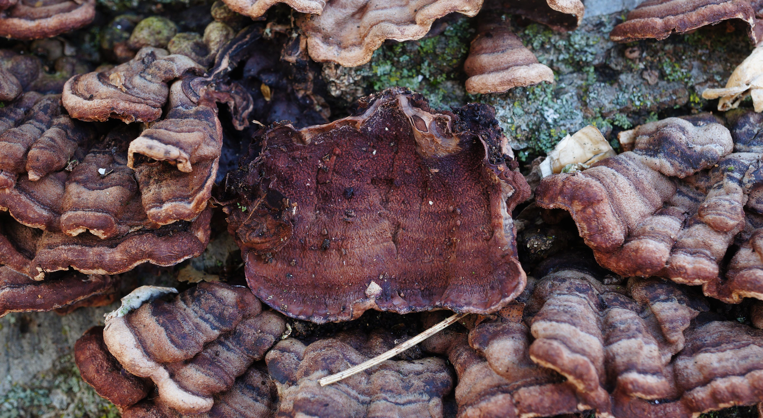
Punctularia strigosozonata (Tree Bacon)
Notes:
ORDER: Corticales
FAMILY: Corticiaceae
FBs vry soft pliable when fresh
Resupinate to effused-reflexed; caps zonate;
hymenium dark reddish brown to dark violaceous; merulioid, made up of irregular ridges, tubercules
on a wide variety of hardwood – we see it mostly on oak – suddenly killed healthy trees
NYMS member Will Scott named it "Tree Bacon". Has not yet caught on on iNaturalist....
(NYMS has started calling Hymenochaete rubiginosa “False Tree Bacon”)

Slide 49
Phlebia coccineofulva
Notes:
ORDER: Polyporales
FAMILY: Meruliaceae
aka P. atkinsoniana
“Coccineo" refers to the scarlet red-orange fertile layer and "fulva" refers to the yellow subiculum beneath it
Found this morel hunting

Slide 50
Phlebia incarnata (Coral Pink Merulius)
Notes:
ORDER: Polyporales
FAMILY: Meruliaceae
special relationship with Stereum

Slide 51
Stereoid Fruit Bodies
“Stereum-Like”
Resupinate, effused-reflexed, stipitate, spathulate / flabellate
Hymenium can be smooth, tuberculate, spiny, merulioid, etc.
Texture can be leathery, coriaceous, woody, etc.

Slide 52
Chondrostereum purpureum (Silverleaf Fungus)
Notes:
ORDER: Agaricales
FAMILY: Cyphellaceae
FBs are usually effused-reflexed
Saprophytic & parasitic on stumps, trunks, branches, of deciduous trees;
Causes Silver Leaf Disease, infecting fruit trees w a toxin that causes the upper epidermis of the leaf to separate from the layer beneath

Slide 53
Hymenochaetopsis corrugata (Alder Glue)
Notes:
ORDER: Hymenochaetales
FAMILY: Hymenochaetaceae
Fully resupinate to effused-reflexed
fka Hymenochaete agglutinans

Slide 54
Cotylidia sp.
Notes:
ORDER: Hymenochaetales
FAMILY: Repetobasidiaceae
FBs are Stipitate, and can become confluent (caps grow together)
Most members of the genus are tropical - sub-tropical;
four species in NA (1 of which is sub-tropical);
they are prob. species complexes;
terrestrial or on woody debris
These would be good candidates for sequencing....

Slide 55
Cystostereum murrayi
Notes:
ORDER: Polyporales
FAMILY: Cystostereaceae
Perennial
FBs are resupinate to effused-reflexed
Can be IDd in the field by contrasting cap/hymenium color, tuberculate hymenium & odor (pleasant, aromatic odor when fresh)
light-colored tuberculate hymenium;
cap (if present), dark, carbonaceous, tough;
dimitic, with generative & skeletal hyphae;
inflated, balloon-like gloeocystidia;
occurs on hardwood & conifer – here it is on birch

Slide 56
Stereopsis burtiana
Notes:
ORDER: Polyporales
FAMILY: Meruliaceae
FBs are spathulate-flabellate to Stipitate
fleshy, soft when fresh, brittle dry;

Slide 57
Stereopsis vitellina
Notes:
ORDER: Polyporales
FAMILY: Meruliaceae
FBs are spathulate-flabellate to stipitate
fleshy; soft when fresh, brittle dry;
on humid, bare soil, often around the entrances of small mammal dens, around tree roots, etc.
Fruits in the same spot year after year - this is under a beech tree in northern NJ, where I've seen it 3 years in a row

Slide 58
Xylobolus subpileatus
Notes:
ORDER: Russulales
FAMILY: Stereaceae
FBs are effused-reflexed
Perennial, on hardwood (mostly oak);
Can look a lot like C. murrayi, but this has a smooth hymenium & under the microscope it is monomitic, has smooth, thick walled, amyloid spores
causes a very slow acting white pocket-rot; that preserves the structural integrity of the wood decades
prob produces anti-fungal chemicals - never see other fungi growing on wood inhabited by it
Don’t see it too often, but can be locally common (everywhere in Great Swamp, NJ) – in NYC we see it Queens, Staten Island – and in the past 3 months Sigrid found it in Bronx, and Prospect Park

Slide 59
Byssoid Fruit Bodies
Resupinate
Cotton-like; made up of delicate threads; floccose
Easily removed from substrate
Most (if not all) are mycorrhizal
Notes:
Floccose: covered with or consisting of woolly tufts
The mycorrhizal corticioid fungi appear to be decomposers, but they’re actually using wood as a stable surface to support their fructifications

Slide 60
Byssocorticium atrovirens
Notes:
ORDER: Atheliales
FAMILY: Atheliaceae
Byssocorticium pulchrum is indistinguishable marcroscopically;
The spores of B. atrovirens are 3-4 m in diameter;
B. pulchrum are larger, 5-6 in diam.
Very common on hardwood logs, woody debris, leaf litter
The yellow/orange rhizomorphs in the pic belonged to a nearby Hydnophlebia chrysorhiza

Slide 61
Piloderma sp.
Notes:
ORDER: Atheliales
FAMILY: Atheliaceae
Piloderma bicolor?
Distinguishing features are the monomitic hyphal system, thick-walled spores, clavate basidia; septate hyphae, no clamps, no cystidia; anastomosed (rhizomorphal) hyphae covered with rod-shaped crystals; subicular hyphae covered with small yellow grains, visible in Melzer’s.
Genus is widespread, contains six species
Usually on decayed wood or litter in acidic forest soils, they can develop on any substrate that offers support: soil, rocks, moss, etc.
The yellow rhizomorphs can be found growing in litter or humus

Slide 62
Tomentella sp.
Notes:
ORDER: Thelephorales
FAMILY: Thelephoraceae
French mycologist Hubert Bourdot said it best: “God created the Corticees, but the Devil created the Tomentellae.”
mycorrhizal; fbs effused, lightly attached to easily separable, hypochnoid to tomentose; rhizomorphs often present; hyphal system dimitic (sometimes with skeletal hyphae in the rhizomorphs); spores echinulate
They are difficult to sort out
This is possibly T. umbrinospora (it has this general aspect/color, and is common on a variety of hardwood trees)

Slide 63
Jelly Fungi
Resupinate, stipitate, spathulate/flabellate, foliaceous
Fruit bodies dry up and revive depending on weather conditions
Some are decomposers, some are parasitic

Slide 64
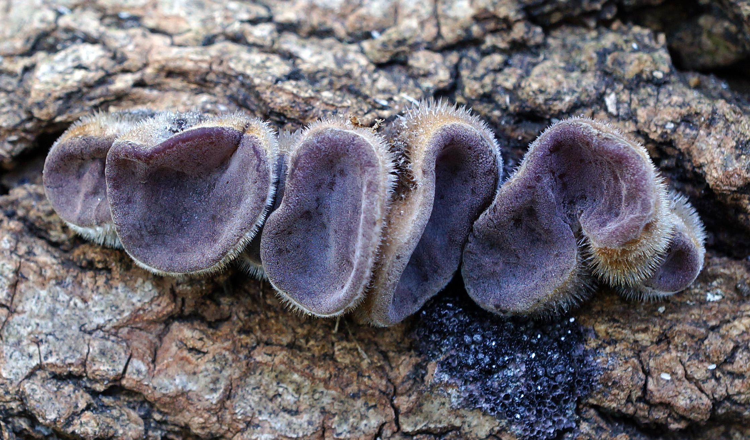
Auricularia cornea
Notes:
Originally described from the Asian Pacific region where it is widespread;
accidentally introduced to the Caribbean in colonial times – perhaps via the Breadfruit trade
Closely related to A. polytricha, another Asian species not found in NA
It is creeping northward – last year Greg Thorn, visiting NYMS from Canada sequenced a collection from Prospect Park, Brooklyn & was surprised to learn it was A. cornea!
The collation pictured here, from Randall’s Island, Manhattan, last November, was sequenced and proved to be A. cornea

Slide 65
Exidia crenata (Amber Jelly)
Notes:
Say goodbye to Exidia recisa and say hello to Exidia crenata!
recent studies have show that Exidia recisa is a European species occurring (almost exclusively) on willow; Exidia recisa has only been confirmed from Newfoundland, also on willow…
Our northeastern Exidia, fruiting on a wide variety of hardwood, was described by Schweinitz in 1822 from eastern PA – Schweinitz bestowed the epithet “crenata”

Slide 66
Ductifera pululahuana (White Jelly Fungus)
Notes:
South America; eastern & southern US
type specimen collected in Pu-lu-la-hu-a, Ecuador
Tremella fuciformis is also white, but translucent

Slide 67
Myxarium nucleatum (Crystal Brain Fungus)
Notes:
Convoluted, translucent to whitish brain-like fbs with hard, white calcareous deposits scattered throughout. A common fall/winter jelly fungus in the NE

Slide 68
Dacryopinax elegans
Notes:
Dacryopinax = tear-shaped; tear-like
Fruiting in large troops through cracks in hardwood
Another more common species is D. spathularia

Slide 69
Guepiniopsis buccina
Notes:
buccin = trumpet
Persoon called it Peziza buccina (didn't use a microscope)…
A capitate jelly fungus…
on hardwood
When dry, the ribs/ridges running down the central stalk become evident
As with species of Calocera, it has tuning fork shaped basida

Slide 70
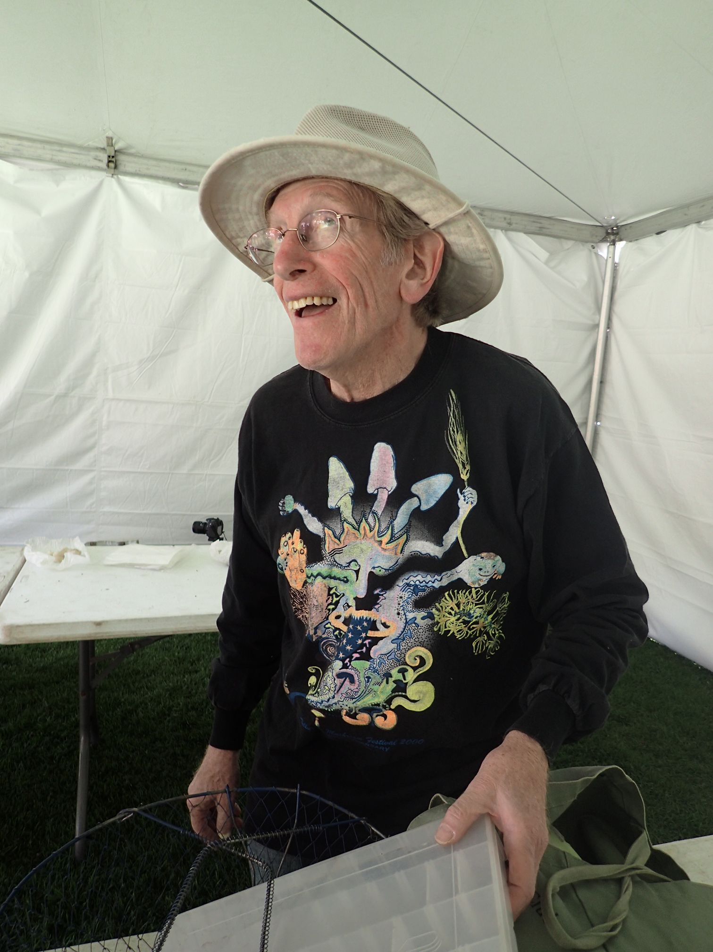
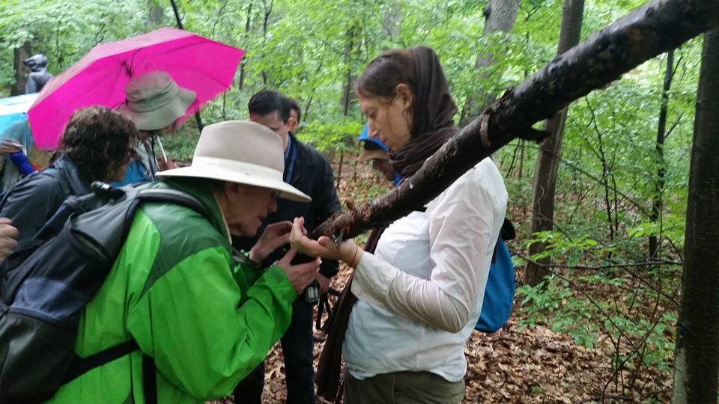
for Gary
Notes:
Dimitrios Floudas, who did his PhD work at the Hibbett Lab at Clark, wrote and article in McIllvainea,
“Where are the Corticioid Fungi in North America?”
where he noted the neglect the group suffers, and how they are largely ignored by amateur mushroom clubs and at regional and national forays. He observes that "collecting corticioid fungi is a lonely activity."
Gary's enthusiasm for these fungi was infectious, and spread like wildfire in the NYMS – making the activity of collecting & studying them anything but lonely - it's largely what started the NYMS holding weekly walks year-round.
Gary always made sure Tom Volk and/or Larry Millman would come to NYC from time to time to help us with them
On his visits to mushrooms clubs all over the country, he tried to get people excited about them (sometimes with little success!)

